Slide 1
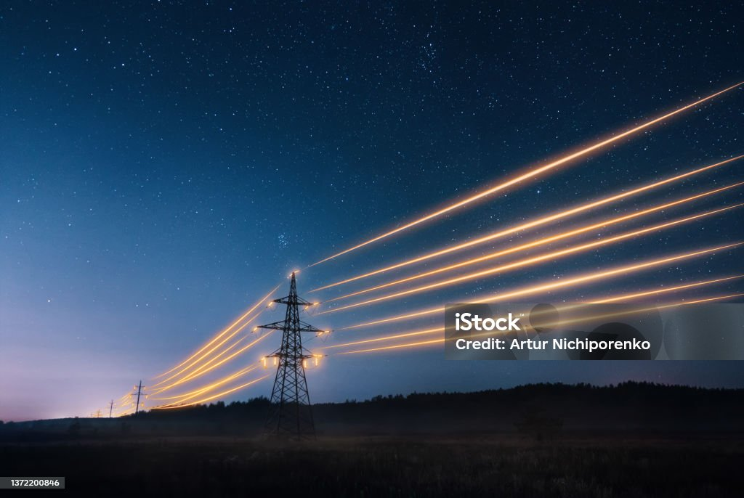
Overview of Power Grids of Germany and USA
Energy Generation, Transmission & Distribution
Abdullah Zunorain
18 Feb 2024

Slide 2
Outline
Executive Summary
Introduction
Methodology
Results
Conclusion
Appendix

Slide 3
Executive Summary
Research Design:
I did collected the data (generation capacity (GW) of Germany and USA) from various online websites.
For Germany: 1. https://www.energy-charts.info/charts/installed_power/chart.htm?l=en&c=DE&chartColumnSorting=ascending&year=2021&partsum=1
2. https://www.energy-charts.info/charts/installed_power/chart.htm?l=en&c=DE&chartColumnSorting=ascending&year=2021&partsum=1
For USA: https://www.eia.gov/energyexplained/electricity/electricity-in-the-us-generation-capacity-and-sales.php
Then I used excel to find the best approach for data analysis and comparision of both countries, for that I did data cleaning, webscrapping upto some extend in google sheet and then I structured the data.
At the end I did data visualization for comparative analysis.

Slide 4
Introduction
An Overview of generation capacity (GW) of Germany and USA
Total Generation Capacity: Germany and the USA are among the leading countries in terms of total generation capacity.
Germany: 211.31 GW
USA: 1.3 million GW
Number of TSOs/ISOs and DSOs in Germany and the USA. Share the names of TSOs of both countries?
Country | Number of TSOs/ISOs | Number of DSOs | Example TSO(s)
Germany | 1 | ~800 | TransnetBW
USA | 3 | ~3,500 | PJM Interconnection, SPP, California ISO

Slide 5
Relevant Stakeholders/Regulators:
Names and roles of relevant stakeholders/regulators in Germany and USA power grid?
Country | Regulator | Stakeholders
Germany | Federal Network Agency (BNetzA) | TSOs
 |  | DSOs
 |  | energy generators
 |  | Consumers
 |  | Industry associations
USA | Federal Energy Regulatory Commission (FERC) | TSOs
 | state Public Utility Commissions (PUCs) | ISOs
 |  | DSOs
 |  | energy generators
 |  | consumers
 |  | Industry associations

Slide 6
Methodology

Slide 7
Methodology
Executive Summary
Data Collection Methodology:
I did search on official reports and publications from governmental agencies and energy organizations.
Review of academic papers, research articles, and studies related to power grids, energy generation, and transmission.
I did analysis of publicly available data from official websites of TSOs, DSOs, and energy regulatory bodies.
I also examinated industry reports and market analysis provided by reputable organizations.
Sources:
https://en.wikipedia.org/wiki/Renewable_energy_in_Germany
https://www.eia.gov/energyexplained/electricity/electricity-in-the-us-generation-capacity-and-sales.php
https://www.statista.com/statistics/220174/total-us-electricity-net-generation-by-fuel/?gad_source=1&gclid=Cj0KCQiAz8GuBhCxARIsAOpzk8xEqPcsK7fLQi6lJniXPGp8_5mOD0ImmaEjp5scgAcgAKztYt8aYjAaAsHWEALw_wcB
https://www.cleanenergywire.org/factsheets/germanys-energy-consumption-and-power-mix-charts

Slide 8
Data Collection
1. Initial Research Phase:
Conducted extensive online research using search engines, AI platforms such as chatgpt etc to identify relevant sources of data.
Explored various reputable websites, including governmental agencies, energy organizations, and academic institutions.
2. Selection of Data Sources:
Identified key databases, reports, and research papers containing pertinent information on power grids, energy generation, and transmission.
Prioritized sources based on credibility, relevance, and availability of data.
3. Data Extraction and Collection:
Extracted relevant data points from online sources, including tables, charts, and textual information(CSV, excel files etc).
Utilized web scraping techniques in Google Sheets to extract structured data from websites and online databases.
Manually collected data from research articles, summaries, and official reports, ensuring accuracy and completeness.

Slide 9
Data Collection
4. Data Preprocessing in Excel:
Transferred collected data into Microsoft Excel for organization and preprocessing.
Cleaned and formatted data to remove inconsistencies, errors, and duplicates.
5. Data Integration and Consolidation:
Integrated data sets from multiple sources into a unified Excel workbook.
Consolidated data into relevant tables and spreadsheets based on thematic categories (e.g., generation capacity, transmission infrastructure, etc).
6. Validation and Quality Assurance:
Cross-referenced data points with multiple sources to validate accuracy and consistency.
Conducted thorough quality checks to identify and rectify any discrepancies or anomalies in the data.
7. Documentation and Citation:
https://en.wikipedia.org/wiki/Electricity_sector_in_Germany
https://en.wikipedia.org/wiki/Solar_power_in_Germany
https://www.energy-charts.info/charts/installed_power/chart.htm?l=en&c=DE&chartColumnSorting=ascending&year=2021&partsum=1
https://www.eia.gov/energyexplained/electricity/electricity-in-the-us-generation-capacity-and-sales.php
https://www.statista.com/statistics/220174/total-us-electricity-net-generation-by-fuel/?gad_source=1&gclid=Cj0KCQiAz8GuBhCxARIsAOpzk8xEqPcsK7fLQi6lJniXPGp8_5mOD0ImmaEjp5scgAcgAKztYt8aYjAaAsHWEALw_wcB
https://www.ise.fraunhofer.de/en/press-media/press-releases/2023/german-net-power-generation-in-first-half-of-2023-renewable-energy-share-of-57-percent.html#:~:text=Hydropower%20produced%209.3%20TWh%20in,131%20TWh%20a%20year%20earlier.
https://www.cleanenergywire.org/factsheets/germanys-energy-consumption-and-power-mix-charts

Slide 10
Data Collection – Germany Energy Production

Slide 11
Data Collection – USA Energy Production

Slide 12
TSOs/ISOs and DSOs in Germany and the USA
Country | Number of TSOs/ISOs | Number of DSOs | Example TSO(s)
Germany | 1 | ~800 | TransnetBW
USA | 3 | ~3,500 | PJM Interconnection, SPP, California ISO

Slide 13
Names and Roles of stakeholders/regulators in Germany and USA
Country | Regulator | Stakeholders
Germany | Federal Network Agency (BNetzA) | TSOs
 |  | DSOs
 |  | energy generators
 |  | Consumers
 |  | Industry associations
USA | Federal Energy Regulatory Commission (FERC) | TSOs
 | state Public Utility Commissions (PUCs) | ISOs
 |  | DSOs
 |  | energy generators
 |  | consumers
 |  | Industry associations

Slide 14
Final Tables
Country | Technology | 2016 | 2017 | 2018 | 2019 | 2020 | 2021
Germany | Coal | 27.44 | 24.04 | 23.82 | 22.67 | 23.74 | 19.04
USA | Coal | 1239.2 | 1205.8 | 1149.5 | 964.96 | 773.39 | 897.89
Germany | Hydro | 3.95 | 3.8 | 3.85 | 4.94 | 4.94 | 4.94
USA | Hydro | 268 | 300 | 292 | 288 | 285 | 252
Germany | Nuclear | 10.8 | 10.8 | 9.52 | 9.52 | 8.11 | 4.06
USA | Nuclear | 805.69 | 804.95 | 807.08 | 809.41 | 789.88 | 778.19
Germany | Solar | 40.68 | 42.29 | 45.31 | 48.86 | 54.36 | 60.08
USA | Solar | 36 | 53 | 64 | 72 | 89 | 115
Germany | Wind | 45.28 | 50.17 | 52.45 | 53.19 | 54.25 | 55.88
USA | Wind | 227 | 254 | 273 | 296 | 338 | 378

Slide 15
Data Visualization – Germany & USA

Slide 16
USA vs. Germany

Slide 17
Analysis of Energy Generation Technologies between Germany and USA
(2016-2021)
1. Coal:
Germany: Coal generation capacity decreased from 27.44 GW in 2016 to 19.04 GW in 2021.
USA: Coal generation capacity exhibited a fluctuating trend, decreasing from 1239.15 GW in 2016 to 897.89 GW in 2021.
Germany's reduction in coal capacity was more significant compared to the USA, indicating a stronger shift away from coal-based generation.
2. Hydro:
Germany: Hydro generation capacity remained relatively stable around 3.8-4.94 GW throughout the period.
USA: Hydro generation capacity fluctuated slightly, with a decrease from 268 GW in 2016 to 252 GW in 2021.
Both countries maintained consistent hydro capacity levels, with Germany having a slight edge in stability.
3. Nuclear:
Germany: Nuclear generation capacity declined significantly from 10.8 GW in 2016 to 4.06 GW in 2021.
USA: Nuclear capacity remained relatively stable, ranging from 778.19 GW to 805.69 GW during the period.
Germany's nuclear capacity saw a drastic reduction, whereas the USA maintained a more consistent level of nuclear generation.

Slide 18
Analysis…
4. Solar:
Germany: Solar generation capacity showed steady growth, increasing from 40.68 GW in 2016 to 60.08 GW in 2021.
USA: Solar capacity experienced substantial growth, rising from 36 GW in 2016 to 115 GW in 2021.
Both countries witnessed significant growth in solar capacity, with the USA showing a more substantial increase over the period.
5. Wind:
Germany: Wind generation capacity showed incremental growth, reaching 55.88 GW in 2021 from 45.28 GW in 2016.
USA: Wind capacity exhibited substantial growth, increasing from 227 GW in 2016 to 378 GW in 2021.
Both countries experienced growth in wind capacity, with the USA showing a more rapid expansion compared to Germany.

Slide 19
Overall Comparison:
Germany demonstrated a shift towards renewable energy sources, particularly solar and wind, with significant reductions in coal and nuclear capacities.
In contrast, the USA also experienced growth in renewable energy, especially in solar and wind, but maintained a higher reliance on coal and nuclear generation throughout the period.
The data suggests that both countries are actively transitioning towards cleaner energy sources, albeit at different rates and with varying levels of success.

Slide 20
Possible Driving Force and Reasons:
Possible driving force and reason why countries like Germany and USA are changing their generation dynamics
Environmental Concerns:
Both Germany and the USA are responding to growing concerns about climate change and the need to reduce greenhouse gas emissions.
Transitioning to cleaner energy sources like wind and solar helps mitigate the environmental impact of power generation.
2. Policy Initiatives:
Governments in both countries have implemented renewable energy targets and incentives to encourage the adoption of clean energy technologies.
Legislation such as the Renewable Energy Sources Act (EEG) in Germany and various state-level initiatives in the USA provide regulatory support for renewable energy development.
3. Economic Viability:
Advancements in renewable energy technologies have led to significant cost reductions, making renewables increasingly competitive with conventional energy sources.
Investing in renewables offers long-term economic benefits, including job creation, energy independence, and reduced energy costs.
4. Energy Security:
Diversifying the energy mix reduces dependence on imported fossil fuels, enhancing energy security and resilience.
Both countries aim to strengthen their energy independence by relying more on domestic renewable resources.
5. Technological Innovation:
Ongoing advancements in renewable energy technologies, energy storage, and grid management systems have made renewables more reliable and efficient.
Innovations such as smart grid technology enable better integration of renewable energy into the grid, improving system stability and flexibility.

Slide 21
Q.) In future, what will be the focus of both countries in terms of their preference among solar and wind energy and why?
Germany:
Focus: Offshore wind and solar integrated with buildings and infrastructure.
Reasons:
Vast coastline and favorable wind conditions for offshore wind.
High population density and existing infrastructure suitable for building-integrated solar.
Need for storage solutions to manage variability of renewables and ensure grid stability.
Hydrogen for long-term storage and decarbonizing other sectors like transportation.
USA:
Focus: Onshore wind and diverse mix of solar (utility-scale and distributed).
Reasons:
Large landmass and diverse wind resources across the country.
Established infrastructure and expertise in utility-scale projects for both wind and solar.
Growing preference for distributed solar generation closer to consumption points.
Potential role for nuclear power depending on policy decisions and economic viability.
Carbon capture and storage as an option for emissions reduction from existing fossil fuel plants.

Slide 22
Q.) What possible consequences this changing generation landscape might have on the grids of Germany and US and what can be done to mitigate these impacts?
1. Grid Stability Challenges: Intermittent renewable sources like solar and wind can cause voltage and frequency fluctuations, challenging grid stability and reliability.
2. Overloading of Transmission Lines: The variability of renewable energy may strain existing transmission infrastructure, potentially leading to congestion and limitations in electricity transport capacity.
3. Integration of Electromobility: The widespread adoption of electric vehicles can create significant spikes in electricity demand, requiring careful planning to avoid grid congestion and distribution network strain.
4. Need for Energy Storage and Microgrids: Energy storage technologies and microgrids offer solutions to mitigate the impacts of renewable energy variability, providing backup power and localized resilience.
5. Regulatory and Policy Frameworks: Clear regulations and policies are crucial to support the integration of renewables into the grid, ensuring compliance with technical standards and promoting grid stability and security.

Slide 23
Energy Storage System Technologies Used in Germany:
Pumped Hydroelectric Storage
Compressed Air Energy Storage (CAES)
Lithium-ion Batteries
Redox Flow Batteries
Sodium-Sulfur Batteries
Lead-Acid Batteries

Slide 24
Applications of Energy Storage Systems in Germany:
Mechanical (PHS):
Grid balancing: Stabilizing fluctuations from renewables and regulating grid frequency.
Long-duration storage: Providing backup power during extended outages.
Electrochemical (Li-ion):
Grid balancing: Fast response for short-term fluctuations.
Residential self-consumption: Storing excess solar energy for later use.
EV charging: Providing peak power for charging stations.
Industrial applications: Smoothing energy demand and facilitating renewable integration.
Future Potential:
Redox Flow Batteries: Large-scale grid storage and long-duration backup.
Sodium-sulfur Batteries: Niche applications like industrial peak shaving.
Novel Technologies: Exploring options like flywheels and hydrogen storage.

Slide 25
Split of Storage Technologies and Applications in Germany (2021):
Technologies:
Pumped Hydroelectric Storage (PHS): Over 95% dominance, primarily for large-scale grid balancing and long-duration storage.
Lithium-ion batteries (Li-ion): Rapidly growing, used for grid balancing, residential self-consumption, EV charging, and industrial applications.
Other technologies (Redox Flow, Sodium-sulfur): Very limited presence, niche applications only.
Applications:
Grid Balancing: PHS and Li-ion dominate, balancing short- and long-term fluctuations while maintaining grid stability.
Residential Self-Consumption: Li-ion batteries store excess solar power for later use in homes.
Industrial Applications: Li-ion batteries aid in smoothing demand peaks and integrating renewable energy into industrial processes.
EV Charging: Li-ion batteries provide peak power for fast charging stations.
Key Points:
PHS remains dominant for large-scale storage due to its mature technology and high capacity.
Li-ion batteries are rapidly gaining share due to versatility and cost decreases.
Other technologies are still in development but hold potential for long-duration storage.
Grid balancing and residential self-consumption are primary applications, with industrial and EV charging gaining traction.

Slide 26
Shore-to-Ship Power Systems: Types & Differences
Types:
High Voltage Shore Connection (HVSC):
Most common, connects directly to high voltage grids (11kV-33kV).
Complex & expensive installation requiring major port infrastructure upgrades.
High voltage cables demand specialized handling and safety measures.
Medium Voltage Shore Connection (MVSC):
Similar to HVSC but uses medium voltage grids (3kV-6kV) for cost-performance balance.
Requires infrastructure upgrades, but less extensive than HVSC.
Medium voltage expertise and safety procedures needed.
Low Voltage Shore Connection (LVSC):
Simplest option, connects directly to low voltage grids (400V-690V) commonly available in ports.
Easy installation often using existing infrastructure.
Lower voltage simplifies handling, but limited power capacity.
Additional Considerations:
Frequency: Some ships may require frequency conversion systems to match shore grid frequency (50Hz or 60Hz).
Standards: Complying with international standards like IEC 80005-1 is crucial for safety and interoperability.
Automation: Advanced systems integrate seamlessly with ship and port power management for efficient operation.

Slide 27
Top 5 European Countries Leading in Shore Power Deployment:
While the entire European continent is seeing an increase in shore power adoption, certain countries stand out as clear leaders due to their proactive policies, favorable infrastructure, and strong market drivers. Here are the top 5, backed by data and explanations:
Norway:
Data: Over 50 ports offer shore power, highest installed base in Europe.
Market Drivers: Government grants, ambitious decarbonization targets, focus on maritime industries.
Examples: Oslo, Bergen, Kristiansand - high penetration of electric ferries and cruise ships.
Sweden:
Data: Pioneered shore power in 2000, 5 major ports with diverse facilities.
Market Drivers: Green Deal initiatives, EU funding, strong environmental awareness.
Examples: Gothenburg, Stockholm - aiming for fossil-free energy in ports by 2025.
Germany:
Data: Significant growth, several ports with high-voltage connections for large vessels.
Market Drivers: Renewable energy focus, emissions reduction goals, port competitiveness.
Examples: Hamburg, Bremerhaven - major investments in infrastructure upgrades.

Slide 28
Continue..
France:
Data: Increasing investment, national plan targeting major ports for shore power rollout.
Market Drivers: EU regulations, port modernization plans, growing LNG market.
Examples: Marseille, Le Havre - key strategic ports implementing shore power facilities.
Italy:
Data: Expanding rapidly, focus on cruise and ferry ports in major tourist destinations.
Market Drivers: Cruise industry pressure, port modernization projects, EU funding support.
Examples: Venice, Civitavecchia - significant investments in shore power infrastructure.
Explanation:
This list reflects the current situation (around February 2024) and the ranking can change based on future developments.
Other countries like Denmark, Finland, and the Netherlands are also actively pursuing shore power deployment.
Key market drivers include regulatory requirements, environmental concerns, economic benefits, and advancements in technology.
Sources:
PTR Inc. Reports: https://ptr.inc/onshore-power-supply-gaining-popularity-in-european-ports/
MarketsandMarkets: https://www.marketsandmarkets.com/Market-Reports/shore-power-market-34338697.html
European Commission: https://commission.europa.eu/strategy-and-policy/priorities-2019-2024/european-green-deal_en

Slide 29
Thanks

